Slide 1

WEEK 5
12th SEPTEMBER–
15th SEPTEMBER
RUT CHOLERA
EMP CODE: 655095

Slide 2
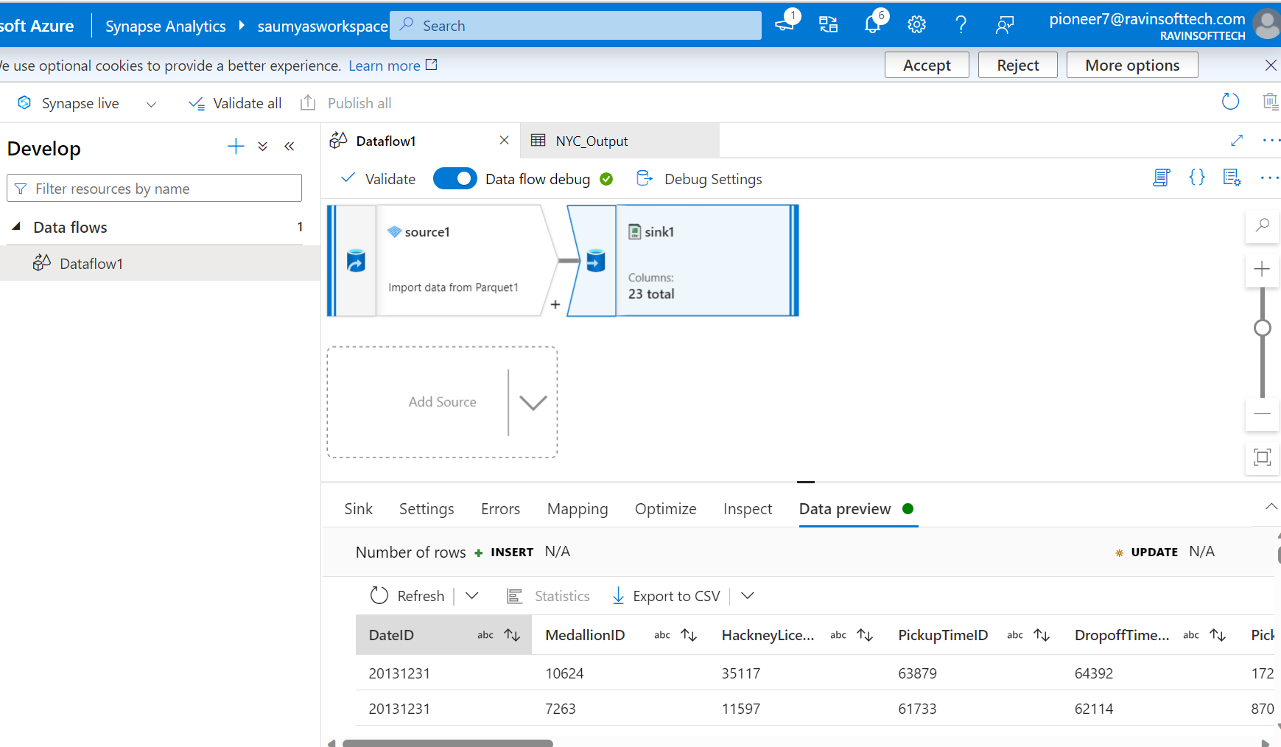
12th September
Azure Synapse Analytics
Serverless SQL Pool in the Azure Synapse Analytics
pipelines, analytics tools & services,

Slide 3
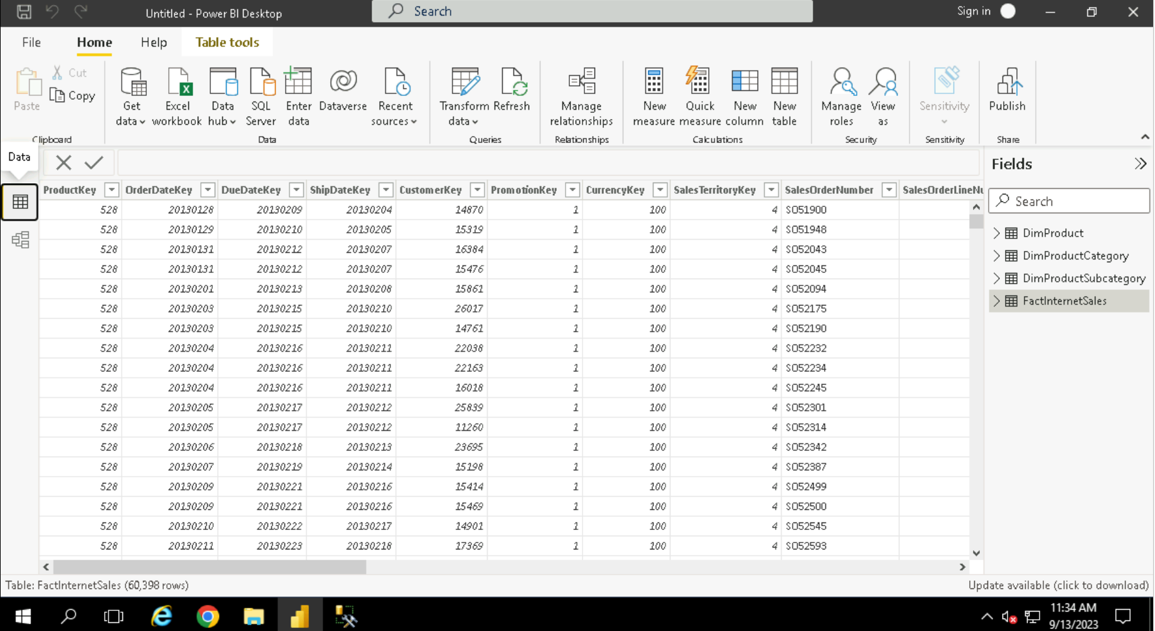
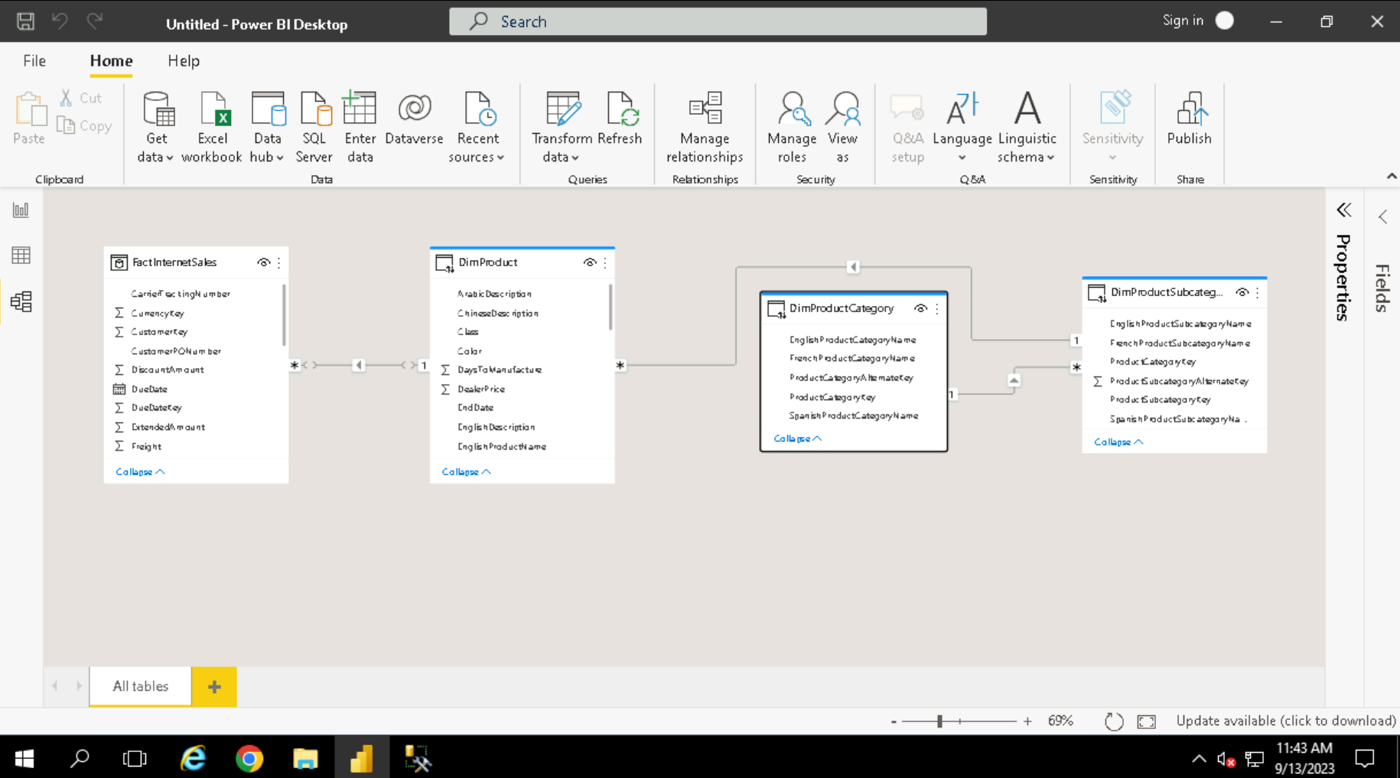
13TH September
POWERBI
Loading data
Transforming data in powerbi
Relations and hierarchy
Creating data visualizations

Slide 4
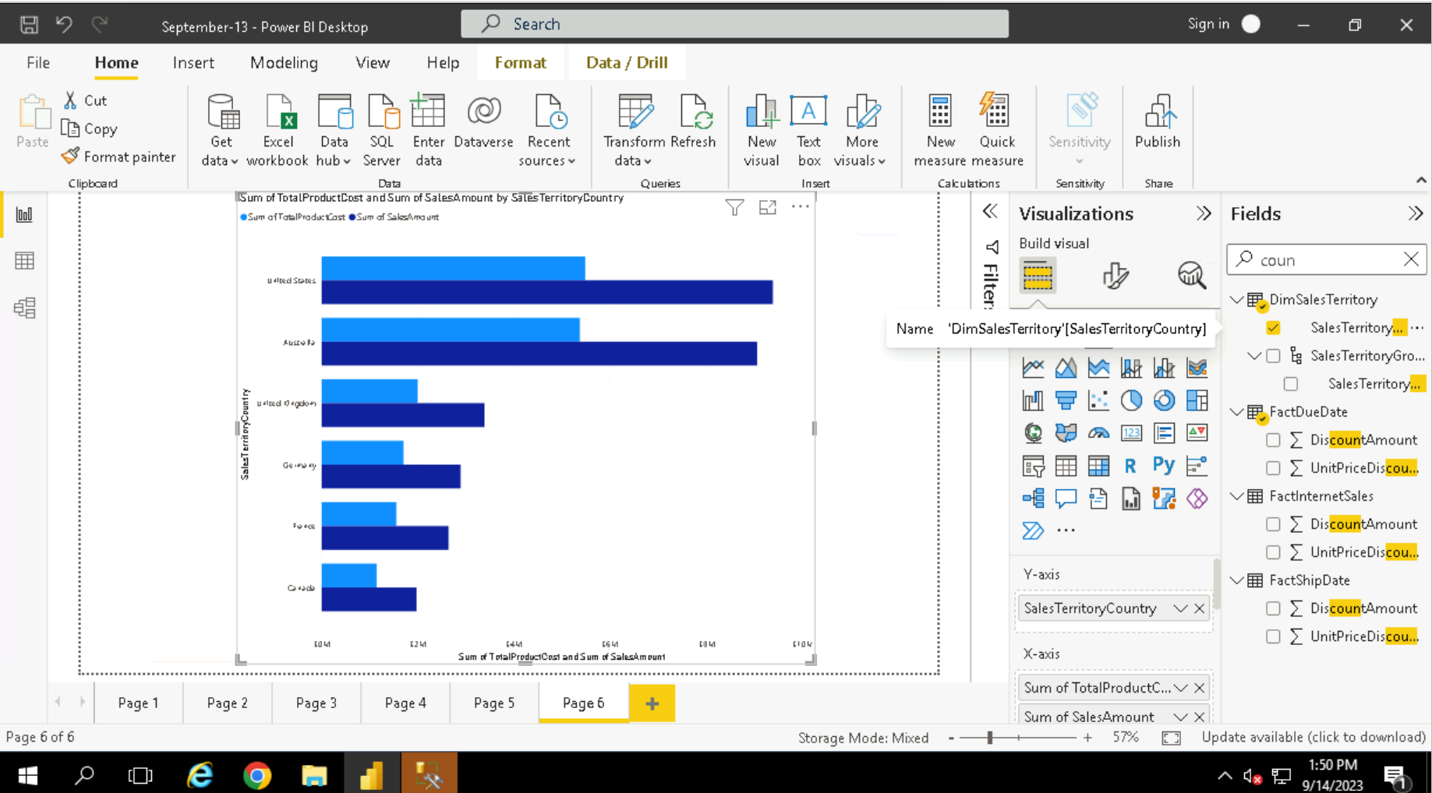
14TH September
More on Powerbi
More graphics and view modifications
Visualizations settings

Slide 5
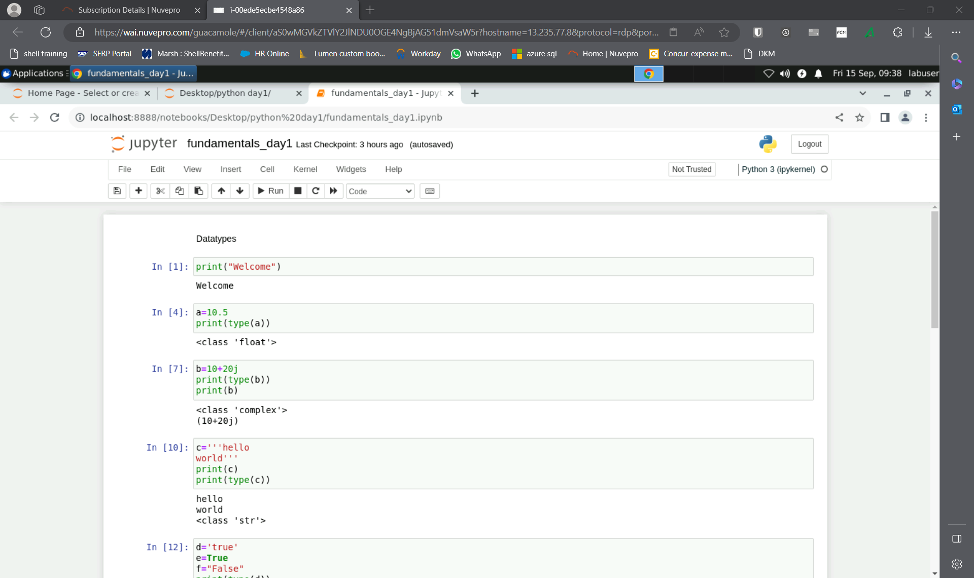
15TH September
Python basics
Slicing
Data types
Lists, tuples,
dictionaries

Slide 6
THANK YOU

